Slide 1
CPT-S 415
Big Data
Yinghui Wu
EME B45

Slide 2
CPT-S 415
Big Data
Beyond Relational Data
Introduction to XML
XML basics
DTD
XML Schema
XML Constraints
Notes:
Object.

Slide 3
Semi-structured Data
In many applications, data does not have a rigidly and predefined schema:
  e.g., structured files, emails, scientific data, XML, JSON.
Managing such data requires rethinking the design of components of a DBMS:
  data model, query language, optimizer, storage system.
XML data underscores the importance of semi-structured data.

Slide 4
Main Characteristics
Schema is not what it used to be:
not given in advance (often implicit in the data)
descriptive, not prescriptive,
partial,
rapidly evolving,
may be large (compared to the size of the data)
Types are not what they used to be:
objects and attributes are not strongly typed
objects in the same collection have different representations.

Slide 5
Example: XML
<bib>
<book year="1995">
<title> Database Systems </title>
<author> <lastname> Date </lastname> </author>
<publisher> Addison-Wesley </publisher>
</book>
<book year="1998">
<title> Foundation for Object/Relational Databases </title>
<author> <lastname> Date </lastname> </author>
<author> <lastname> Darwen </lastname> </author>
<ISBN> <number> 01-23-456 </number > </ISBN>
</book>
</bib>

Slide 6
Example: Data Integration
user
Mediator: uniform access to multiple data sources
Structured
file
Legacy
system
RDBMS
OODBMS
Each source represents data differently:
different data models, different schemas

Slide 7
Physical versus Logical Structure
In some cases, data can be modeled in relational or object-oriented models, but extracting the tuples is hard
  extracting data from HTML:
    [Ashish and Knoblock, 97], [Hammer et al., 97], [Kushmerick and Weld, 97].
Semi-structured data: when the data cannot be modeled naturally or usefully using a standard data model.

Slide 8
Managing Semi-structured Data
How do we model it? (directed labeled graphs).
How do we query it? (many proposals, all include regular path expressions).
Optimize queries? (beginning to understand).
Store the data? (looking for patterns)
Integrity constraints, views, updates,…,
We start with introduction of XML

Slide 9
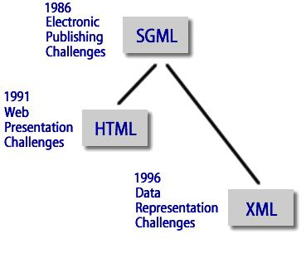
History: SGML, HTML, XML
SGML: Standard Generalized Markup Language
-- Charles Goldfarb, ISO 8879, 1986
powerful and flexible tool for structuring
information, but
  complete, generic implementation of SGML
  is difficult
  tools for working with SGML documents are expensive
two sub-languages that have outpaced SGML:
  HTML: HyperText Markup Language (Tim Berners-Lee, 1991). Describing presentation.
  XML: eXtensible Markup Language, W3C, 1998. Describing content.

Slide 10
From HTML to XML
HTML is good for presentation (human friendly), but does not help automatic data extraction by means of programs (not computer friendly).
Why? HTML tags:
predefined and fixed
describing display format, not the structure of the data.
<h3> George Bush </h3>
  <b> Taking CPTS 580-05 </b> <br>
  <em> GPA: 1.5 </em> <br>
  <h3> Sloan 163 </h3>
  <b> Big Data </b>

Slide 11
XML: a first glance
XML tags:
user defined
describing the structure of the data
<school>
<student id = “011”>
<name>
<firstName>George</firstName> <lastName>Bush</lastName>
  </name>
  <taking> CPTS 415</taking>
  <GPA> 1.5 </GPA>
</student>
<course cno = “CPTS 415”>
  <title> Big Data</title>
</course>
</school>

Slide 12
XML vs. HTML
user-defined new tags, describing structure instead of display
structures can be arbitrarily nested (even recursively defined)
optional description of its grammar (DTD) and thus validation is possible
What is XML for?
The prime standard for data exchange on the Web
A uniform data model for data integration
XML presentation:
XML standard does not define how data should be displayed
Style sheet: provide browsers with a set of formatting rules to be applied to particular elements
  CSS (Cascading Style Sheets), originally for HTML
  XSL (eXtensible Style Language), for XML

Slide 13
Tags and Text
XML consists of tags and text
<course cno = “Eng 055”>
  <title> Spelling </title>
</course>
tags come in pairs: markups
  start tag, e.g., <course>
  end tag, e.g., </course>
tags must be properly nested
  <course> <title> … </title> </course> -- good
  <course> <title> … </course> </title> -- bad
XML has only a single “basic” type: text, called PCDATA (Parsed Character DATA)

Slide 14
XML Elements
Element: the segment between an start and its corresponding end tag
subelement: the relation between an element and its component elements.
  <person>
<name> Yinghui Wu </name>
<tel> (509) 335-7612</tel>
<email> yinghui@eecs.wsu.edu </email>
<email> yinghui@wsu.edu </email>
</person>

Slide 15
Nested Structure
nested tags can be used to express various structures,
e.g., “records”:
  <person>
<name> Yinghui Wu </name>
<tel> (509) 335-7612</tel>
<email> yinghui@eecs.wsu.edu </email>
<email> yinghui@wsu.edu </email>
</person>
a list: represented by using the same tags repeatedly:
<person> … </person>
<person> … </person>
...

Slide 16
Ordered Structure
XML elements are ordered!
How to represent sets in XML?
How to represent an unordered pair (a, b) in XML?
Can one directly represent the following in a relational database?
  <person> … </person>
<person> … </person> …
  <person>
<name> Yinghui Wu </name>
<tel> (509) 3357612 </tel>
<email> Yinghui@eecs.wsu.edu </email>
<email> Yinghui@wsu.edu </email>
</person>
Notes:
Using schema;
Via schema mapping. – transform schema; transform data constraints; multiple value; redesign.

Slide 17
XML attributes
A start tag may contain attributes describing certain “properties” of the element (e.g., dimension or type)
<picture>
<height dim=“cm”> 2400</height>
<width dim=“in”> 96 </width>
<data encoding=“gif”> M05-+C$ … </data>
</picture>
References (meaningful only when a DTD is present):
<person id = “011” pal=“012”>
<name> Barack Obama </name>
</person>
<person id = “012” pal=“011”>
<name> Hillary Clinton </name>
</person>

Slide 18
The “structure” of XML attributes
XML attributes cannot be nested -- flat
the names of XML attributes of an element must be unique.
one can’t write <person pal=“Blair” pal=“Saddam”> ...
XML attributes are not ordered
  <person id = “011” pal=“012”>
  <name> Barack Obama </name>
  </person>
is the same as
  <person pal=“012” id = “011”>
  <name> Barack Obama </name>
  </person>
Attributes vs. subelements: unordered vs. ordered, and
  attributes cannot be nested (flat structure)
  subelements cannot represent references

Slide 19
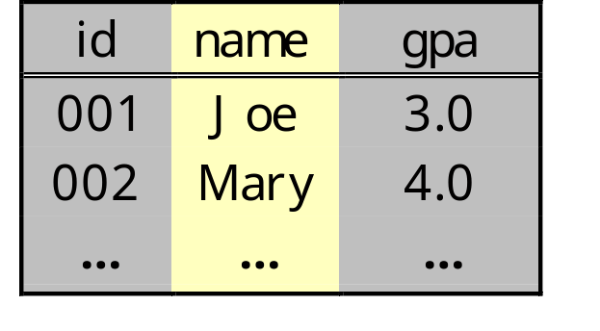
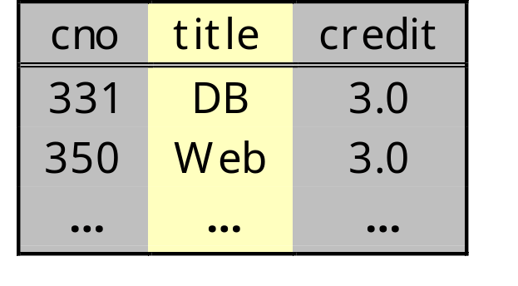
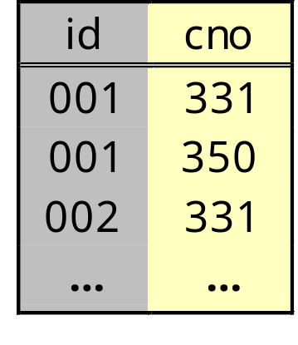
Representing relational databases
A relational database for school:
student: course:
enroll:

Slide 20
XML representation
<school>
  <student id=“001”>
  <name> Joe </name> <gpa> 3.0 </gpa>
  </student>
  …
  <course cno=“331”>
  <title> DB </title> <credit> 3.0 </credit>
  </course>
  …
  </course>
  <enroll>
  <id> 001 </id> <cno> 331 </cno>
  </enroll>
  …
</school>

Slide 21
The XML tree model
An XML document is modeled as a node-labeled ordered tree.
Element node: typically internal, with a name (tag) and children (subelements and attributes), e.g., student, name.
Attribute node: leaf with a name (tag) and text, e.g., @id.
Text node: leaf with text (string) but without a name.
db
...
student
student
course
course
@id
name
taking
taking
title
@cno
“123”
“Eng 055”
firstName
lastName
title
@cno
“Spelling”
“Eng 055”
“George”
“Bush”
“Spelling”

Slide 22
Introduction to XML
XML basics
DTDs
XML Schema
XML Constraints

Slide 23
Document Type Definition (DTD)
An XML document may come with an optional DTD – “schema”
<!DOCTYPE db [
<!ELEMENT db (book*)>
<!ELEMENT book (title, authors*, section*, ref*)>
<!ATTLIST book isbn ID #required>
<!ELEMENT section (text | section)*>
<!ELEMENT ref EMPTY>
<!ATTLIST ref to IDREFS #implied>
<!ELEMENT title #PCDATA>
<!ELEMENT author #PCDATA>
<!ELEMENT text #PCDATA>
]>

Slide 24
Element Type Definition (1)
for each element type E, a declaration of the form:
<!ELEMENT E P> E → P
where P is a regular expression, i.e.,
P ::= EMPTY | ANY | #PCDATA | E’ |
P1, P2 | P1 | P2 | P? | P+ | P*
  E’: element type
  P1 , P2: concatenation
  P1 | P2: disjunction
  P?: optional
  P+: one or more occurrences
  P*: the Kleene closure

Slide 25
Element Type Definition (2)
Extended context free grammar: <!ELEMENT E P>
E.g., book → title, authors*, section*, ref*
single root: <!DOCTYPE db [ … ] >
subelements are ordered.
The following two definitions are different. Why?
<!ELEMENT section (text | section)*>
<!ELEMENT section (text* | section* )>
How to declare E to be an unordered pair (a, b)?
<!ELEMENT E ((a, b) | (b, a)) >
recursive definition, e.g., section, binary tree:
<!ELEMENT node (leaf | (node, node))
<!ELEMENT leaf (#PCDATA)>

Slide 26
Element Type Definition (3)
more on recursive DTDs
<!ELEMENT person (name, father, mother)>
<!ELEMENT father (person)>
<!ELEMENT mother (person)>
What is the problem with this? How to fix it?
  Attributes
  optional (e.g., father?, mother?)
<!ELEMENT person (name, father?, mother?)>
<!ELEMENT father (person) >
<!ELEMENT mother (person)>

Slide 27
Attribute declarations
General syntax:
<!ATTLIST element_name
attribute-name attribute-type default-declaration>
example: “keys” and “foreign keys”
<!ATTLIST book
isbn ID #required>
<!ATTLIST ref
to IDREFS #implied>
Note: it is OK for several element types to define an attribute of the same name, e.g.,
<!ATTLIST person name ID #required>
<!ATTLIST pet name ID #required>

Slide 28
XML reference mechanism
ID attribute: unique within the entire document.
  An element can have at most one ID attribute.
  No default (fixed default) value is allowed.
    #required: a value must be provided
    #implied: a value is optional
IDREF attribute: its value must be some other element’s ID value in the document.
IDREFS attribute: its value is a set, each element of the set is the ID value of some other element in the document.
<person id=“898” father=“332” mother=“336”
children=“982 984 986”>

Slide 29
Specifying ID and IDREF attributes
<!ATTLIST person
id ID #required
father IDREF #implied
mother IDREF #implied
children IDREFS #implied>
e.g.,
<person id=“898” father=“332” mother=“336”
children=“982 984 986”>
….
</person>

Slide 30
Valid XML documents
A valid XML document must have a DTD.
It conforms to the DTD:
  elements conform to the grammars of their type definitions (nested only in the way described by the DTD)
  elements have all and only the attributes specified by the DTD
  ID/IDREF attributes satisfy their constraints:
    ID must be distinct
    IDREF/IDREFS values must be existing ID values

Slide 31
Introduction to XML
XML basics
DTDs
XML Schema
XML Constraints

Slide 32
DTDs vs. schemas (types)
By the database (or programming language) standard, XML DTDs are rather weak specifications.
  Only one base type -- PCDATA.
  No useful “abstractions”, e.g., unordered records.
  No sub-typing or inheritance.
  IDREFs are not typed or scoped -- you point to something, but you don’t know what!
XML extensions to overcome the limitations.
  Type systems: XML-Data, XML-Schema, SOX, DCD
  Integrity Constraints
Notes:
Numeric? Strings? Integers?

Slide 33
XML Schema
Official W3C Recommendation
A rich type system:
Simple (atomic, basic) types for both element and attributes
Complex types for elements
Inheritance
Constraints
  key
  keyref (foreign keys)
  uniqueness: “more general” keys
. . .
See www.w3.org/XML/Schema for the standard and much more

Slide 34
Atomic types
string, integer, boolean, date, …,
enumeration types
restriction and range [a-z]
list: list of values of an atomic type, …
Example: define an element or an attribute
  <xs:element name=“car” type=“carType”>
  <xs:attribute name=“car” type =“carType”>
Define the type:
  <xs:simpleType name=“carType”>
  <xs:restriction base=“xs:string”>
  <xs:enumeration value=“Audi”>
  <xs:enumeration value=“BMW”>
  </xs:restriction>
</xs:simpleType>

Slide 35
Complex types
Sequence: “record type” – ordered
All: record type – unordered
Choice: variant type
Occurrence constraint: maxOccurs, minOccurs
Group: mimicking parameter type to facilitate complex type definition
Any: “open” type – unrestricted
…

Slide 36
Example
A complex type for publications:
  <xs:complexType name=“publicationType”>
  <xs:sequence>
  <xs:choice>
  <xs:group ref=“journalType”>
  <xs:element name=“conference” type=“xs:string”/>
  </xs:choice>
  <xs:element name=“title” type=“xs:string”/>
  <xs:element name=“author” type=“xs:string”
  minOccur=“0” maxOccur=“unbounded”/>
  </xs:sequence>
  </xs:complexType>

Slide 37
Example (cont’d)
  <xs:group name=“journalType”>
  <xs:sequence>
  <xs:element name=“name” type=“xs:string”/>
  <xs:element name=“volume” type=“xs:integer”/>
  <xs:element name=“number” type=“xs:integer”/>
  </xs:sequence>
  </xs:group>

Slide 38
Inheritance -- Extension
Subtype: extending an existing type by including additional fields
<xs:complexType name=“datedPublicationType”>
  <xs:complexContent>
  <xs:extension base=“publicationType”>
  <xs:sequence>
  <xs:element name=“isbn” type=“xs:string”/>
  </xs:sequence>
  <xs:attribute name=“publicationDate” type=“xs:date”/>
  </xs:extension>
  </xs:complexContent>
  </xs:complexType>

Slide 39
Inheritance -- Restriction
Supertype: restricting/removing certain fields of an existing type
<xs:complexType name=“anotherPublicationType”>
  <xs:complexContent>
  <xs:restriction base=“publicationType”>
  <xs:sequence>
  <xs:choice>
  <xs:group ref=“journalType”>
  <xs:element name=“conference” type=“xs:string”/>
  </xs:choice>
  <xs:element name=“author” type=“xs:string”
  minOccur=“0” maxOccur=“unbounded”/>
  </xs:sequence>
  </xs:restriction>
  </xs:complexContent>
</xs:complexType>
Removed title
Notes:
Removes title information

Slide 40
Introduction to XML
XML basics
DTDs
XML Schema
XML Constraints

Slide 41
Keys and Foreign Keys
Example: school document
  <!ELEMENT db (student+, course+) >
  <!ELEMENT student (id, name, gpa, taking*)>
  <!ELEMENT course (cno, title, credit, taken_by*)>
  <!ELEMENT taking (cno)>
  <!ELEMENT taken_by (id)>
keys: locating a specific object, an invariant connection from an object in the real world to its representation
  student.@id → student, course.@cno → course
foreign keys: referencing an object from another object
taking.@cno ⊆ course.@cno, course.@cno → course
  taken_by.@id ⊆ student.@id, student.@id → student

Slide 42
Constraints are important for XML
Constraints are a fundamental part of the semantics of the data; XML may not come with a DTD/type – thus constraints are often the only means to specify the semantics of the data
Constraints have proved useful in
  semantic specifications: obvious
  query optimization: effective
  database conversion to an XML encoding: a must
  data integration: information preservation
  update anomaly prevention: classical
  normal forms for XML specifications: “BCNF”, “3NF”
  efficient storage/access: indexing,
  …

Slide 43
The limitations of the XML standard (DTD)
ID and IDREF attributes in DTD vs. keys and foreign keys in RDBs
Scoping:
  ID unique within the entire document while a key needs only to uniquely identify a tuple within a relation
  IDREF untyped: one has no control over what it points to -- you point to something, but you don’t know what it is!
  <student id=“01” name=“Hillary” taking=“CPTS580”/>
  <student id=“02” name=“Bush” taking=“CPTS580 05”/>
  <course id=“CPTS580”/>

Slide 44
The limitations of the XML standard (DTD)
keys can be multi-valued, while IDs must be single-valued (unary)
enroll (sid: string, cid: string, grade:string)
a relation may have multiple keys, while an element can have at most one ID (primary)
ID/IDREF can only be defined in a DTD, while XML data may not come with a DTD/schema
ID/IDREF, even relational keys/foreign keys, fail to capture the semantics of hierarchical data – will be seen shortly

Slide 45
New challenges of hierarchical XML data
How to identify in a document
a book?
a chapter?
a section?
db
book
book
book
book
title
chapter
chapter
title
chapter
chapter
“XML”
number
section
section
number
section
section
“SGML”
number
number
“1”
number
text
number
“6”
number
number
“1”
“10”
“1”
“Bush, a C student,...”
“1”
“5”
“10”

Slide 46
Path expressions
Path expression: navigating XML trees
A simple path language:
q ::= ε | l | q/q | //
ε: empty path
l: tag
q/q: concatenation
//: descendants and self – recursively descending downward

Slide 47
To overcome the limitations
Absolute key: (Q, {P₁, . . ., P_{k}} )
target path Q: to identify a target set [[Q]] of nodes on which the key is defined (vs. relation)
a set of key paths {P₁, . . ., P_{k}}: to provide an identification for nodes in [[Q]] (vs. key attributes)
semantics: for any two nodes in [[Q]], if they have all the key paths and agree on them up to value equality, then they must be the same node (value equality and node identity)
( //student, {@id})
( //student, {//name})
( //enroll, {@id, @cno})
( //, {@id})

Slide 48
Value equality on trees
Two nodes are value equal iff
either they are text nodes (PCDATA) with the same value;
or they are attributes with the same tag and the same value;
or they are elements having the same tag and their children are pairwise value equal
db
person
person
...
person
person
@phone
name
name
name
@pnone
“123-4567”
“234-5678”
firstName
lastName
firstName
lastName
“JohnDoe”
“George”
“Bush”
“George”
“Bush”

Slide 49
Capturing the semistructured nature of XML data
independent of types – no need for a DTD or schema
no structural requirement: tolerating missing/multiple paths
(//person, {name}) (//person, {name, @phone})
db
person
person
person
person
@phone
name
name
name
@pnone
“123-4567”
“234-5678”
firstName
lastName
firstName
lastName
“JohnDoe”
“George”
“Bush”
“George”
“Bush”

Slide 50
Relative constraints
Relative key: (Q, K)
path Q identifies a set [[Q]] of nodes, called the context;
k = (Q’, {P₁, . . ., P_{k}} ) is a key on sub-documents rooted at nodes in [[Q]] (relative to Q).
Example. (//book, (chapter, {number}))
(//book/chapter, (section, {number}))
        (//book, {title}) -- absolute key

Slide 51
Examples of XML constraints
absolute (//book, {title})
relative (//book, (chapter, {number}))
relative (//book/chapter, (section, {number}))
db
book
book
book
book
title
chapter
chapter
title
chapter
chapter
“XML”
number
section
section
number
section
section
“SGML”
number
number
“1”
number
text
number
“6”
number
number
“1”
“10”
“1”
“Bush, a C student,...”
“1”
“5”
“10”

Slide 52
Absolute vs. relative keys
Absolute keys are a special case of relative keys:
  (Q, K) when Q is the empty path
Absolute keys are defined on the entire document, while relative keys are scoped within the context of a sub-document
Important for hierarchically structured data: XML, scientific databases, …
absolute (//book, {title})
relative (//book, (chapter, {number}))
relative (//book/chapter, (section, {number}))
XML keys are more complex than relational keys!

Slide 53
Summary and Review
XML is a prime data exchange format.
DTD provides useful syntactic constraints on documents.
XML Schema extends DTD by supporting a rich type system
Integrity constraints are important for XML, yet are nontrivial
Exercise:
Design a DTD and an XML Schema to represent student, enroll and course relations. Give necessary XML constraints
Convert student and course relations to an XML document based on your DTD/Schema
Is XML capable of modeling an arbitrary relational/object-oriented database?
Take a look at XML interface: DOM (Document-Object Model), SAX (Simple API for XML). What are the main differences?
Study tutorials for XPath, XSLT and XQuery

